Slide 1

NEBP Paintball CoDR
October 28, 2023

Slide 2
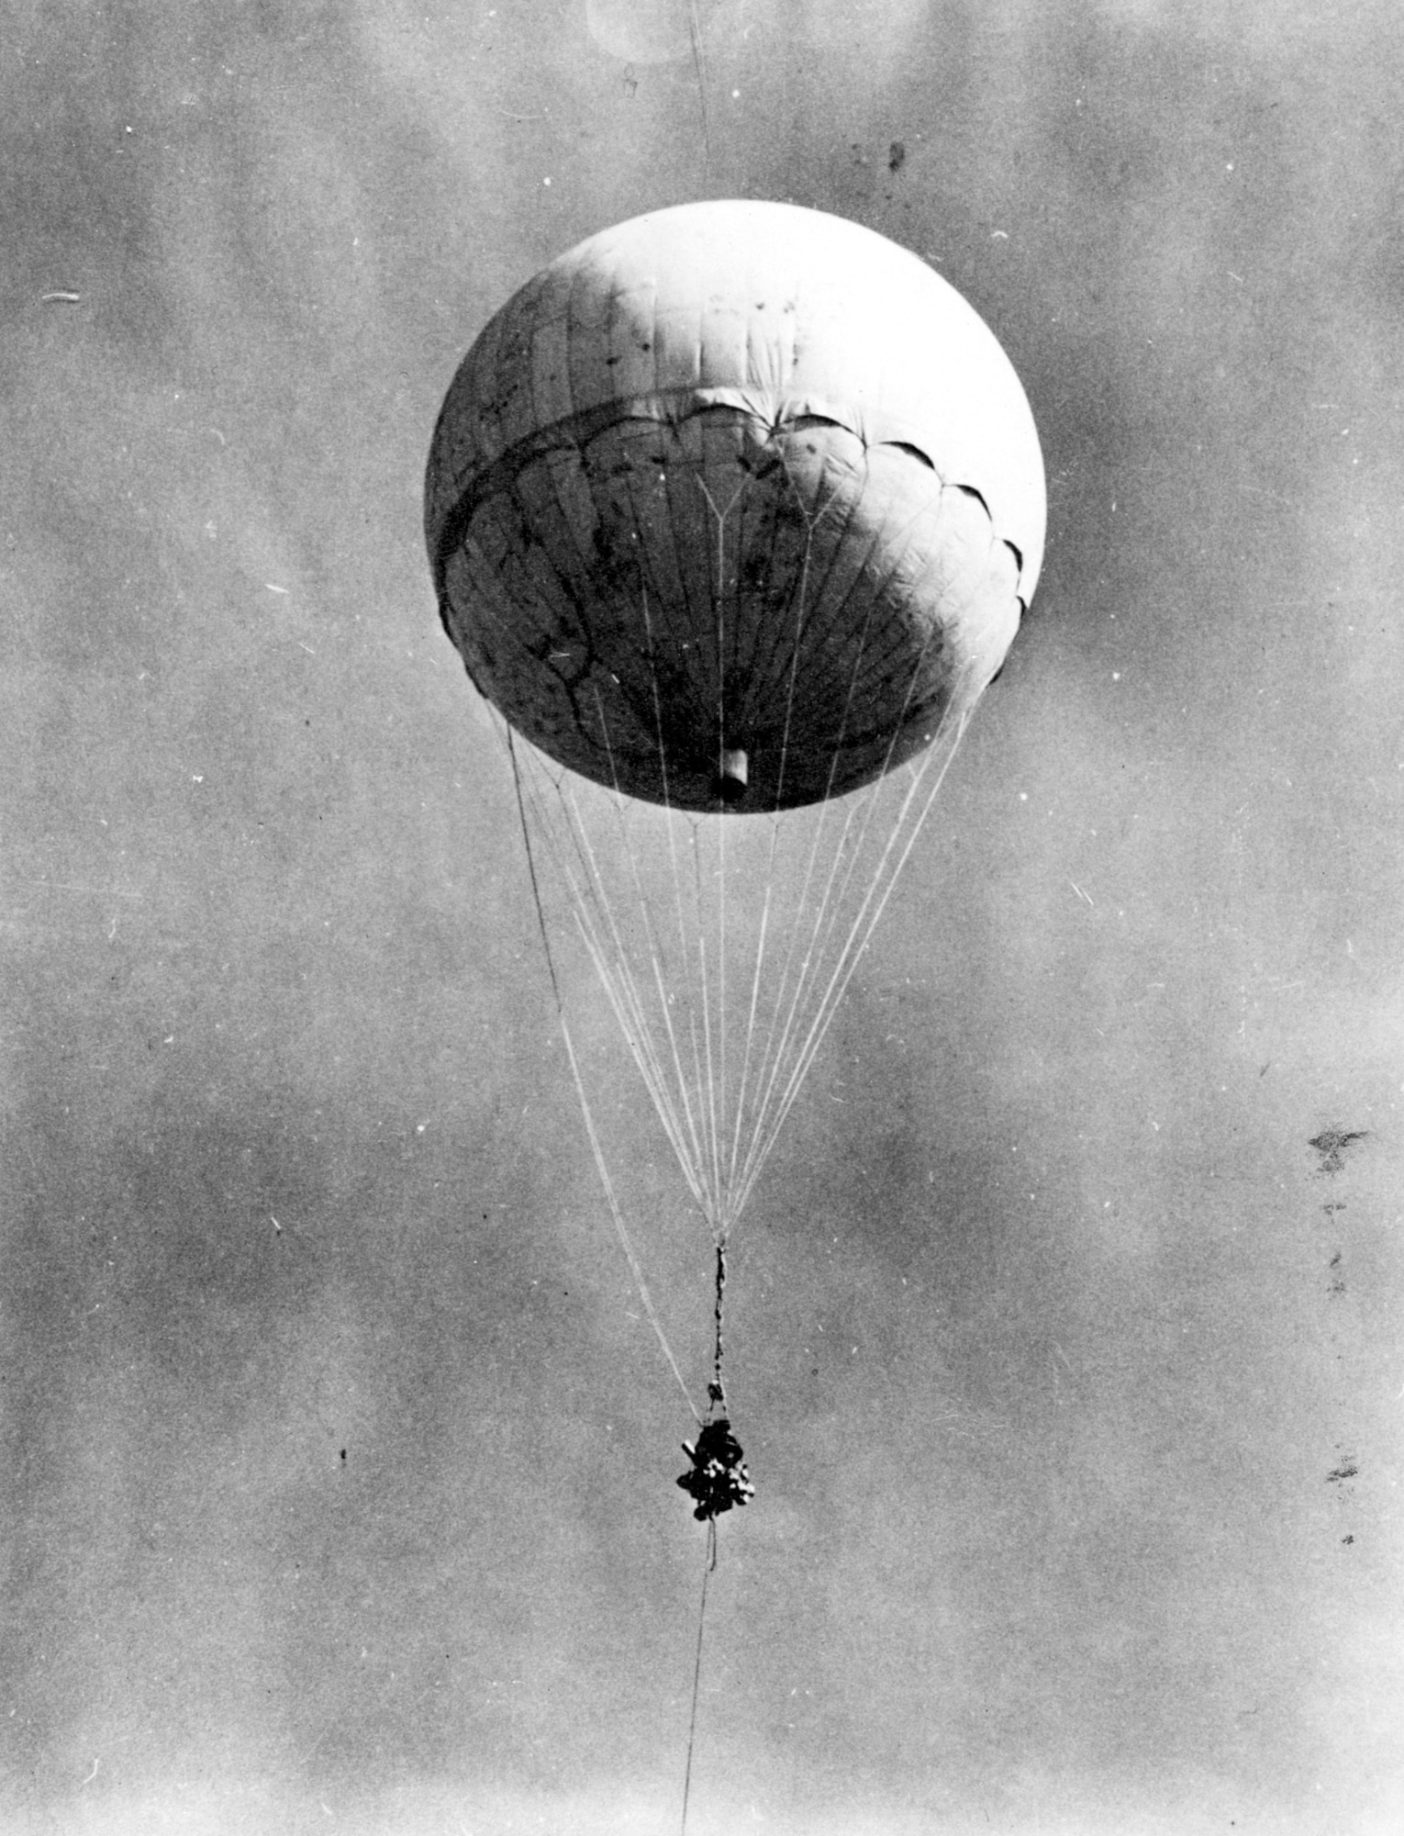
CoDR Content
Mission Overview
Mission Statement
Mission Objectives
Success Criteria
Expected Results
Design Overview
Engineering Design
Sensor Overview
Conclusion
‹#›

Slide 3
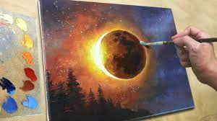
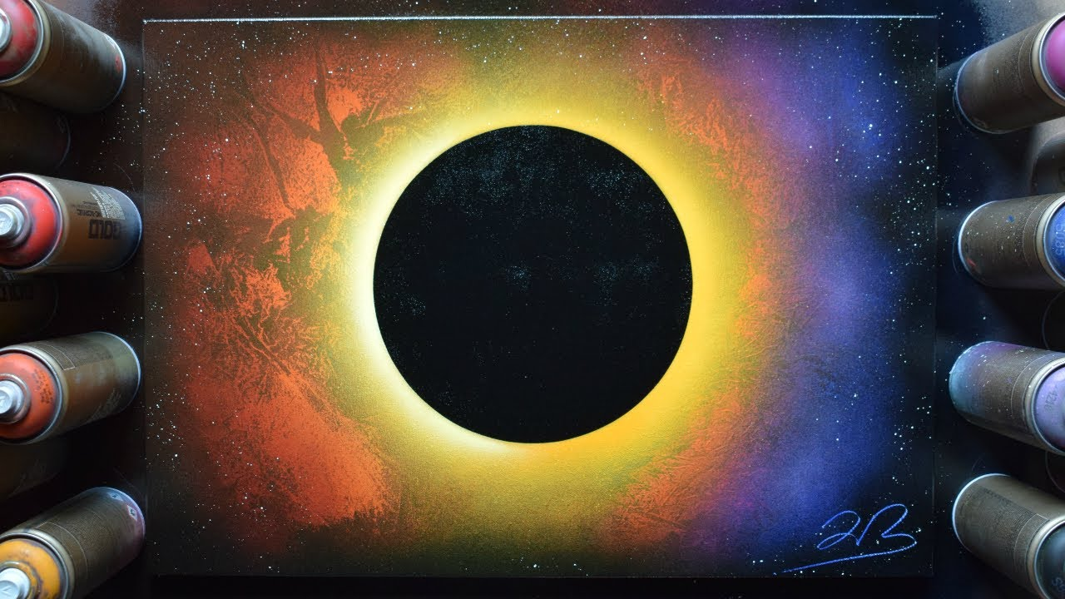
Mission Overview
Mission Statement
Mission Objectives
Expected Results
Success Criteria

Slide 4
Mission Statement
Mission statement: The University of Nebraska - Lincoln looks to produce a novel space painting system.
The success of this project will be determined based on how many of the paint balloons popped at the desired altitude and how accurate the space painting is to a previously rendered design.
Throughout the history of man, no one has successfully autonomously created a painting 90,000 ft in the air.
‹#›

Slide 5
Mission Objectives
Provide a hands-on flight project experience for undergraduate students
Develop the professional and leadership skills of the team
Engage students in a multidisciplinary project environment
Investigate a scientific or technological concept that is relevant to NASA and its strategic goals
Create a painting of a total eclipse during a total eclipse 90,000 ft above sea level
‹#›

Slide 6
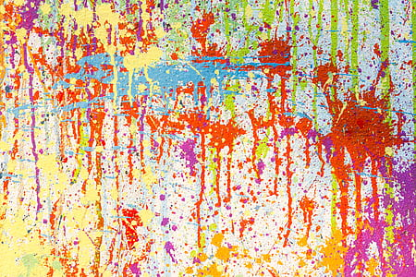
Minimum Success Criteria
The balloons burst to create an image on the canvas
We are able to record the pressure and altitude at which the balloons burst
The paint remains liquid throughout the launch
We are able to retrieve the payload at the end of the launch

Slide 7
Desired Results
We will get a video of the launch
We will also be able to measure altitude, pressure, acceleration, and temperature around and within the payload
We will be able to locate the payload once it lands
The paint balloons will explode at some point to create a splatter portrait
We will try to get the painting on display at the Sheldon Art Museum

Slide 8
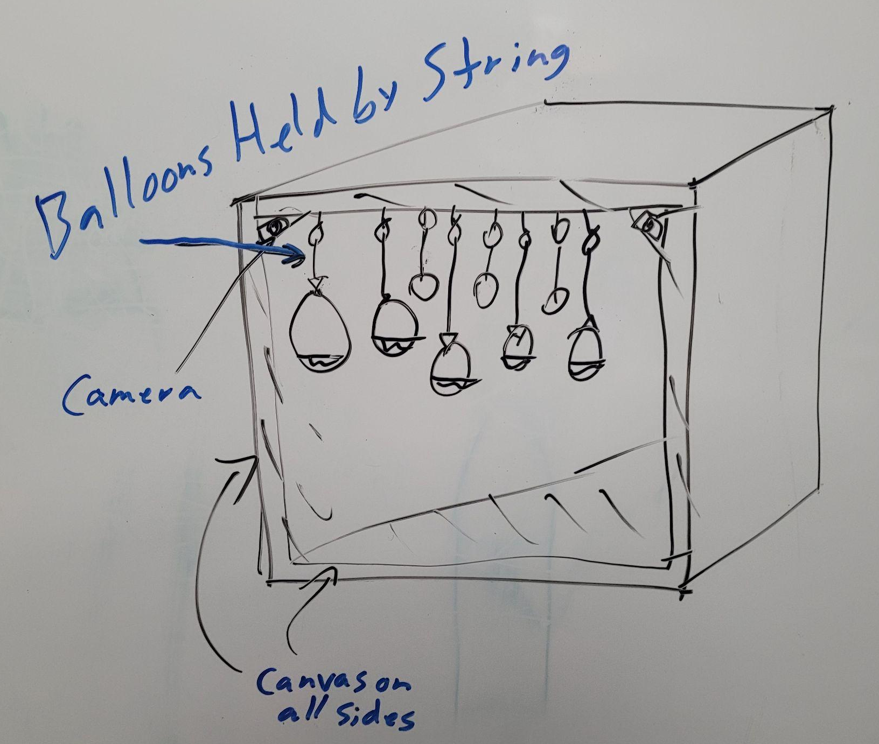
Engineering Design
Put a small amount of paint mixed with paint thinner in a water balloon and fill the balloon with air
These balloons will be hung from the top of the payload with string
Canvases will be attached to the base and sides

Slide 9
Sensor Overview
Camera - to video the painting being made
Pressure sensor - to monitor the pressures at which the balloons pop
Altimeter - to measure the altitude at which the balloons pop
Temperature sensor - to see the changes in temperature at high altitudes and how it affects the paint
Tracker - to find the payload after the descent
Accelerometer - to measure the acceleration of the balloon

Slide 10
Preliminary Testing
We tested adding paint to the balloons and filling them with air from an air compressor until they pop
From this, we learned about the paint splatter and how much the balloons stretch, as well as the stretch difference of the balloons based on the rate of expansion

Slide 11
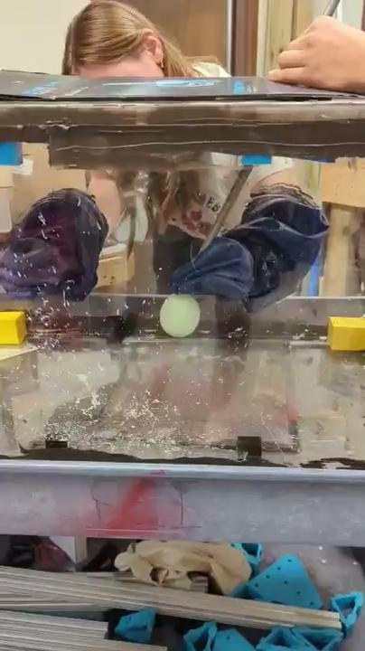
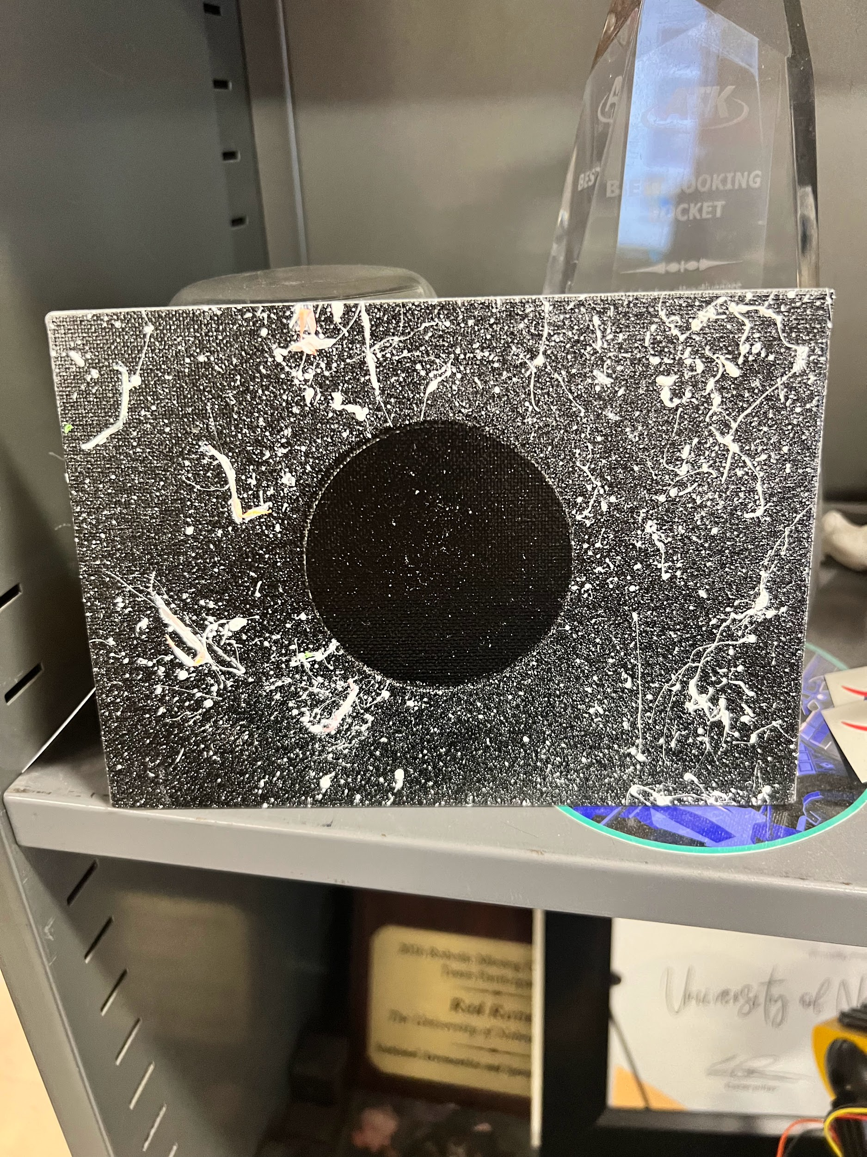

Slide 12
Upcoming Testing
Measuring the pressure at which water balloons pop
Deciding how much air should be added to the balloons for ideal splatter
Possibly learning to make our own balloons out of liquid latex

Slide 13
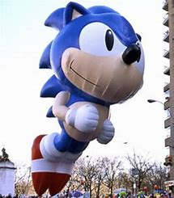
Conclusions
We will learn how to manipulate latex into popping at a specific pressure
We will learn how paint balloons behave under different pressure and temperature environments

